Slide 1
Object parts are first detected and the corresponding part-specific features are extracted for fine-grained classification. However, these methods typically treat the part-specific featuresof each image in isolation while neglecting their relationships between different images??????
a cross-layer regularizer that improves the robust-
ness of multi-scale features by matching the prediction dis-
tribution across multiple layers.?????

Slide 2
Cross-X Learning for Fine-Grained Visual Categorization
Wei Luo1,2 Xitong Yang2 Xianjie Mo1 Yuheng Lu2,5 Larry S. Davis2 Jun Li3 Jian Yang4 Ser-Nam Lim5 1South China Agricultural University 2University of Maryland, College Park 3MIT 4Nanjing University of Science and Technology 5Facebook AI
Notes:
第一页

Slide 3
Abstract
Q: Recognizing objects from subcategories with very subtle differences.
A: Cross-X learning that exploits the relationships between different images and between different network layers for robust multi-scale feature learning.
Idear: A cross-category cross-semantic regularizer and A cross-layer regularizer.
Notes:
第二页

Slide 4
Introduction
weakly-supervised FGVC
1.exploiting relationships between fine-grained labels to regularize feature learning。
2.localizing discriminative parts for part-specific feature extraction。
Q:These methods localize semantic parts independently on each image while neglecting the relationships between the part-pecific features from different images。
A:Cross-X learning,

Slide 5
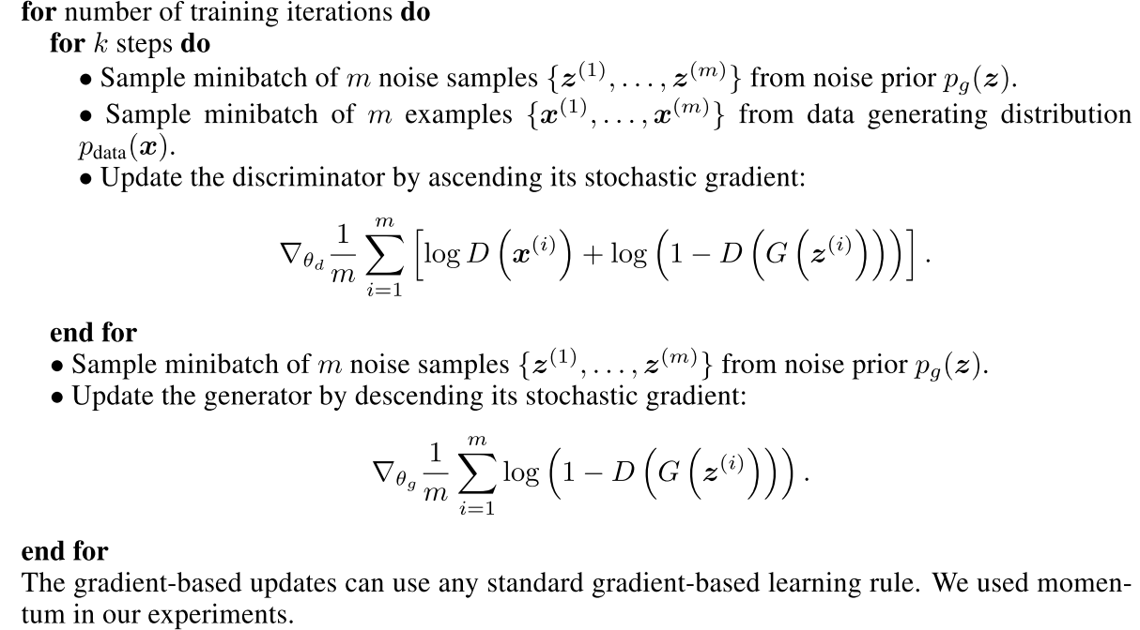
Adversarial nets

Slide 6
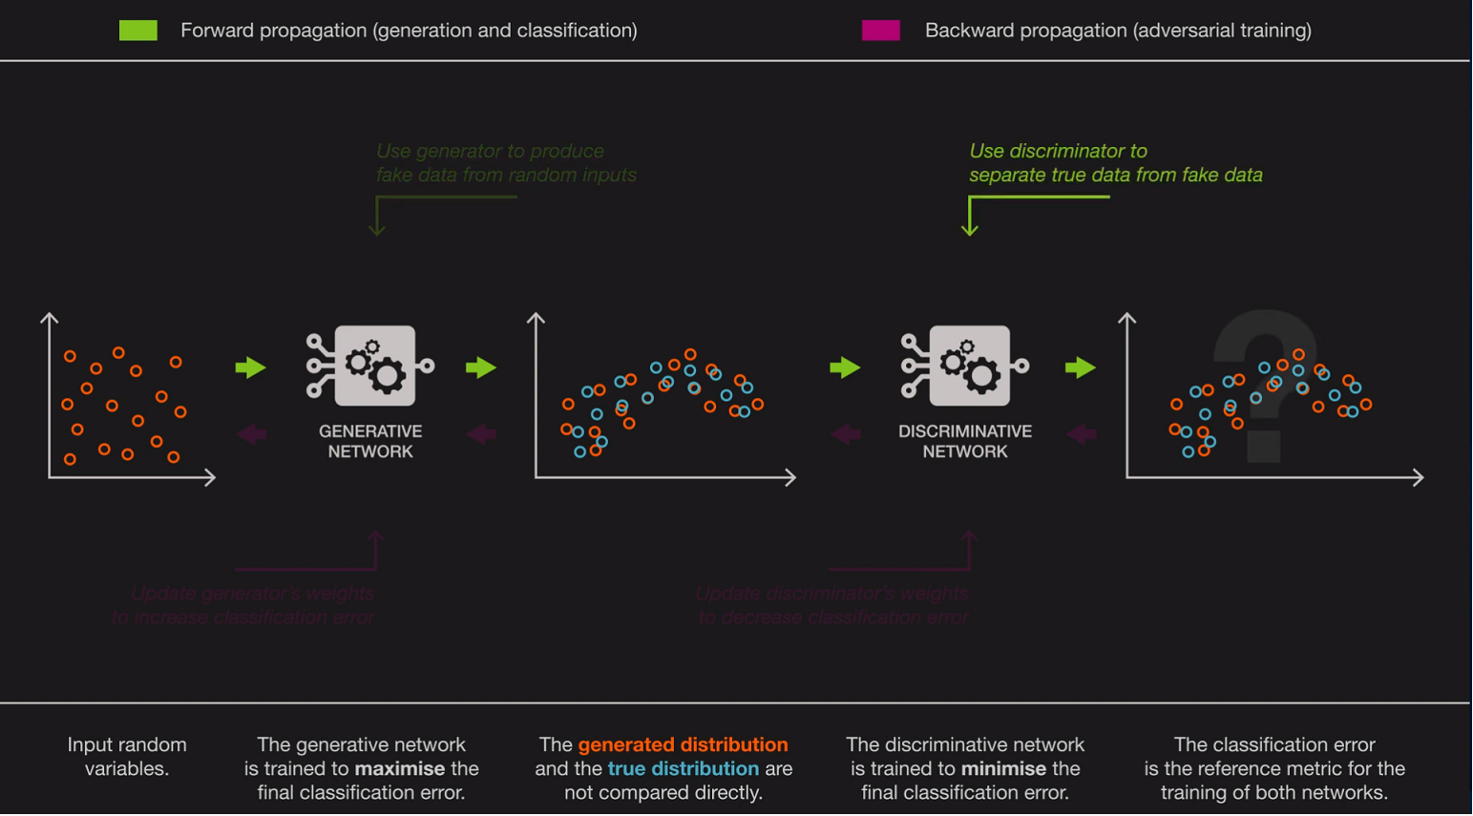

Slide 7
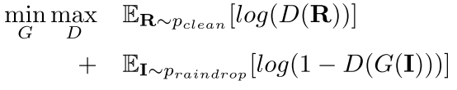
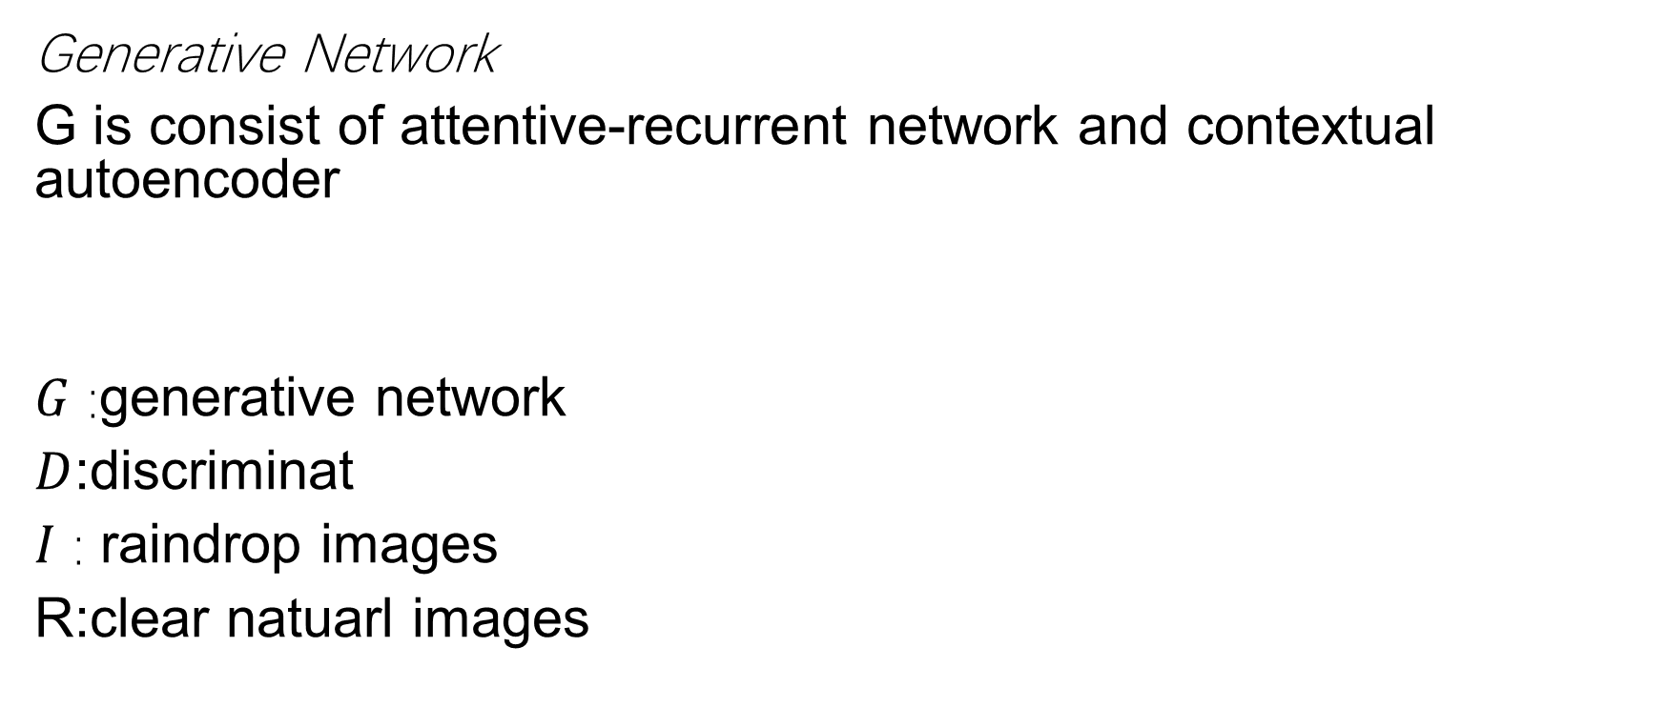
Raindrop Removal using Attentive GAN
Generative Network
G is consist of attentive-recurrent network and contextual autoencoder
$G$ :generative network
$D$:discriminat
$I$ : raindrop images
R:clear natuarl images

Slide 8
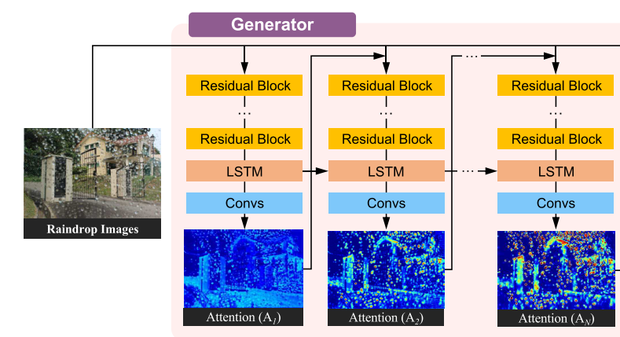
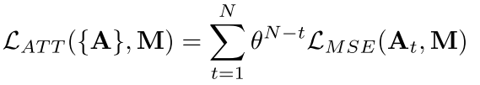
1.Attentive-Recurrent Network
attentivere current network is to find regions in the input image that need to get attention.

Slide 9
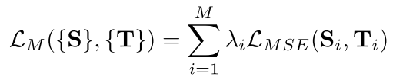


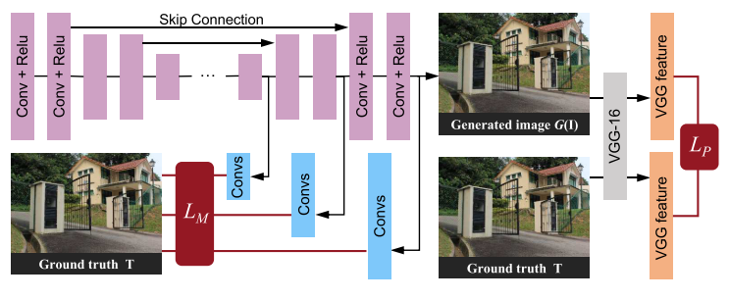
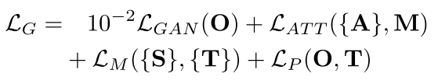
2.Contextual Autoencoder
The purpose of our contextual autoencoder is to generate an image that is free from raindrops
Multi-scale losses:
Perceptual loss:
Discriminative Network

Slide 10

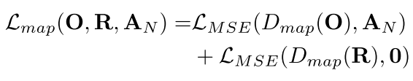
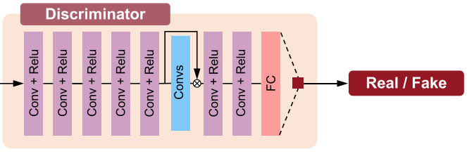
Discriminative Network
The purpose of our contextual autoencoder is to generate an image that is free from raindrops
Multi-scale losses:
Perceptual loss:

Slide 11
Conclusion
G produces the attention map via an attentive-recurrent network and applies this map along with the input image to generate a raindrop-free image through a contextual autoencoder。
Our novelty lies on the use of the attention map in both generative and discriminative network。

